Slide 1
Module 6
Storage

Slide 2
Outline
MODULE 6 INTRODUCTION
  Introduction to Storage
BLOCK STORAGE
  EC2 Instance Store and Amazon Elastic Block Store (Amazon EBS)
  Amazon Elastic Block Store (Amazon EBS) Data Lifecycle
OBJECT STORAGE
  Amazon Simple Storage Service (Amazon S3)
  Amazon S3 Storage Classes and S3 Lifecycle
  Amazon S3 Demonstration
FILE STORAGE
  Amazon Elastic File System (Amazon EFS)
  Amazon FSx
ADDITIONAL STORAGE SOLUTIONS
  AWS Storage Gateway
  AWS Elastic Disaster Recovery
CLOUD IN REAL LIFE
  Comparing Storage Services

Slide 3
Introduction to Storage

Slide 4
In this lesson, you will learn:
Describe and differentiate between block, object, and file storage.
Identify the primary AWS services for block, object, and file storage.
Identify how the AWS shared responsibility model applies to AWS storage services.

Slide 5
AWS cloud storage types
AWS offers three distinct types of cloud storage to meet diverse requirements and application needs:
  Block storage.
  Object storage.
  File storage.

Slide 6
Block storage
Block storage provides persistent, low-latency block-level storage volumes that attach to EC2 instances like physical hard drives.
Block storage volumes can be encrypted, backed up via snapshots, and modified while in use without disrupting the instance.
AWS offers two primary block storage services:
  Amazon EC2 instance store
  An unmanaged non-persistent, high-performance block storage directly attached to EC2 instances for temporary data.
  Amazon Elastic Block Store (EBS)
  A managed service that provides persistent block storage volumes for EC2 instances, offering various types for different workloads

Slide 7
Object storage
Object storage is a data storage architecture that manages data as objects in a flat address space.
It offers unlimited scalability so you can store vast amounts of unstructured data without worrying about capacity constraints.
Object storage provides enhanced metadata capabilities to provide more efficient data management, search, and analytics across massive datasets.
The following is the primary AWS object storage service:
  Amazon Simple Storage Service (S3)
  A fully managed scalable object storage service for storing and retrieving any amount of data from anywhere.

Slide 8
File storage
AWS file storage services provide shared file systems accessible over networks, so multiple users and applications can access the same data simultaneously.
They offer scalability and flexibility so you can expand storage capacity as needs grow without managing physical infrastructure.
AWS offers two primary file storage services:
  Amazon Elastic File System (EFS)
  A fully managed, scalable NFS file system for use with AWS Cloud services and on-premises resources.
  Amazon FSx
  A fully managed file storage services for popular file systems like Windows, Lustre, and NetApp ONTAP.

Slide 9
Additional storage services
These services don't fit cleanly into the categories we've defined so far, but they're important AWS storage offerings that you should be familiar with.
  AWS Storage Gateway
  A fully managed, hybrid-cloud storage service that provides on-premises access to virtually unlimited cloud storage.
  AWS Elastic Disaster Recovery
  A fully managed service that streamlines the recovery of your physical, virtual, and cloud-based servers into AWS.

Slide 10
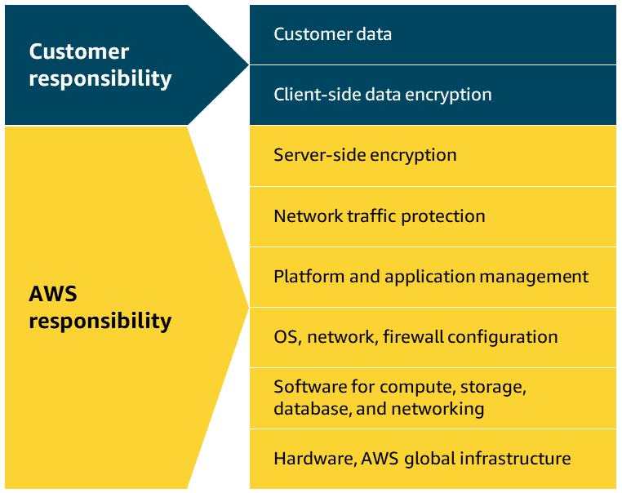
AWS shared responsibility for storage services
The AWS shared responsibility model groups services into three categories based on the ownership of administrative tasks. These categories are fully managed, managed, and unmanaged.
Fully managed services
  For fully managed storage services, AWS is responsible for everything from the hardware and infrastructure up through the entire storage stack.
  This includes data durability, availability, encryption at rest, and replication.
  Customers are only responsible for data management, access controls, and proper service configuration.

Slide 11
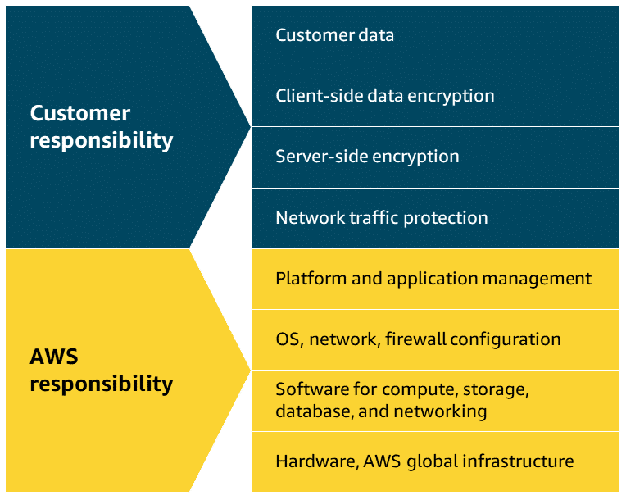
AWS shared responsibility for storage services
Managed services
  For managed storage services, AWS manages
  the underlying storage infrastructure, hardware
  redundancy, and volume replication.
  Customers are responsible for data backup
  strategies, encryption configuration, volume
  performance optimization, and capacity planning.

Slide 12
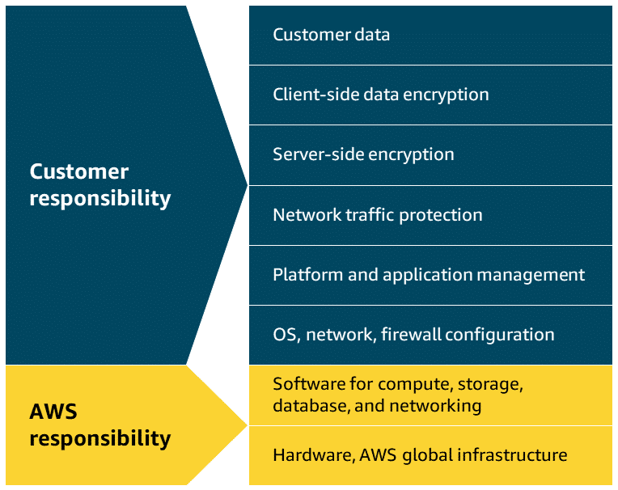
AWS shared responsibility for storage services
Unmanaged services
  For unmanaged storage services, customers takes full responsibility for data management, backup/recovery, encryption, performance optimization, and durability. AWS only maintains the underlying physical hardware and network infrastructure.

Slide 13
EC2 Instance Store and Amazon
Elastic Block Store (Amazon EBS)

Slide 14
In this lesson, you will learn:
Describe Amazon EC2 instance store, including its benefits and use cases.
Describe Amazon EBS, including its benefits and use cases.

Slide 15
Amazon EC2 instance store
Amazon EC2 instance store isn't a stand-alone AWS block storage service.
Rather, it refers to the block-level storage that is physically attached to the EC2 instance host computer.
Depending on the type of instance, EC2 instance store might come attached as the default storage.
Since its data is lost when an instance is stopped or terminated, EC2 instance store is best for temporary memory-based storage needs like buffers, caches, and scratch data.
It is not recommended for applications that require data retention.

Slide 16
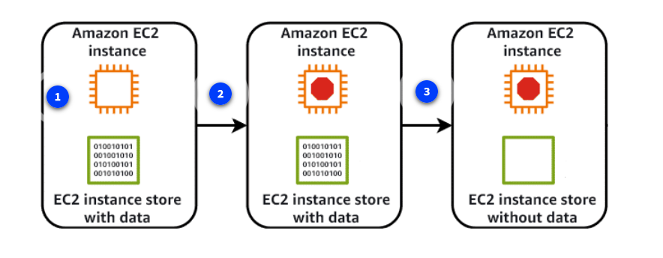
Amazon EC2 instance store
Key takeaway: no data persistence
  An Amazon EC2 instance store provides temporary block-level storage for an Amazon EC2 instance.
  This means that if you stop or terminate an Amazon EC2 instance, all the data written to the attached instance store is deleted.

Slide 17
Amazon EC2 instance store
Benefits
  Auto available storage
    Instance store volumes come automatically attached to many EC2 instance types, providing temporary block-level storage at no additional cost.
    It's physically connected to the host computer, offering high I/O performance for data that disappears when the instance stops.
  Cost effective
    Because EC2 instance store is included in the EC2 instance price, you don't have to pay any additional fees for storage.
    It's ideal for temporary storage needs like buffers, caches, or scratch data, potentially reducing expenses for applications that don't require persistent storage.
  High performance
    EC2 instance store offers extremely low-latency storage directly attached to the host server of your EC2 instance.
    This proximity means exceptionally high I/O performance, making it ideal for temporary storage of data requiring fast processing.

Slide 18
Amazon Elastic Block Store (EBS)
Amazon EBS provides persistent block-level storage volumes for use with Amazon EC2 instances.
EBS volumes act like external hard drives, offering consistent and low-latency performance for workloads like databases and file systems.
EBS volumes can be conveniently backed up, resized, and attached to different EC2 instances.
To create an EBS volume, you define the configuration for things like volume size and type.
After the volume has been created, it can be attached to an Amazon EC2 instance.
Because EBS volumes are for data that needs to persist, it’s important to back up the data.
It's recommended that you take incremental backups of EBS volumes by creating Amazon EBS snapshots.

Slide 19
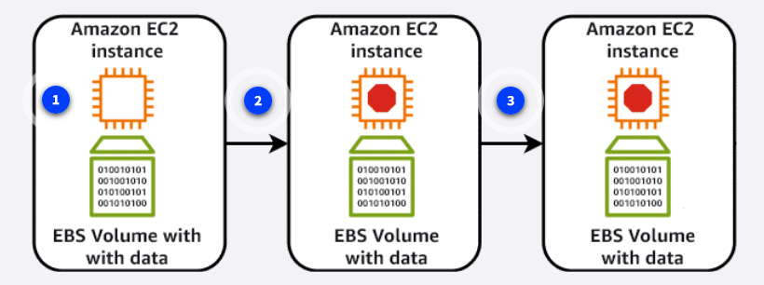
Amazon Elastic Block Store (EBS)
Key takeaway: data persistence
  Amazon EBS provides block-level storage volumes that you can use with Amazon EC2 instances.
  If you stop or terminate an Amazon EC2 instance, all the data on the attached EBS volume remains available.

Slide 20
Amazon Elastic Block Store (EBS)
Use cases
  Some practical use cases of Amazon EBS include database hosting, backup storage for applications, and rapid deployment of development environments using volume snapshots.
Benefits
  EBS volumes support data portability through their ability to detach and reattach to instances as needed.
  There are many practical reasons you might choose to do this.

Slide 21
Amazon Elastic Block Store (EBS)
Benefits (cont.)
  Data migration
    EBS volumes can be easily migrated between Availability Zones using snapshots.
    The snapshots provide a simple way to move data across regions or create copies.
  Instance type changes
    Since EBS volumes remain independent of EC2 instances, it's not complicated to attach them to different instance types.
    This flexibility lets you upgrade or downgrade instances without losing data.
  Disaster recovery
    EBS snapshots provide reliable backup solutions that can be restored in different regions during emergencies.
    Regular automated snapshots ensure your data remains protected and quickly recoverable.
  Cost optimization
    EBS volumes can be modified to different types and sizes to match actual usage patterns.
    You can switch between storage types or adjust capacity without downtime.
  Performance tuning
    Amazon EBS offers various volume types to match different workload requirements and IOPS needs.
    You can adjust volume performance characteristics on the fly to meet changing application demands.

Slide 22
Amazon EBS Data Lifecycle

Slide 23
In this lesson, you will learn:
Describe Amazon EBS snapshots and their use cases for data management.
Describe the Amazon EBS data lifecycle and how it integrates with AWS services.
Identify the customer responsibility in relation to EBS snapshots and Amazon Data Lifecycle Manager

Slide 24
Amazon EBS Data Lifecycle
Amazon EBS data lifecycle management involves creating, backing up, and deleting volumes and snapshots.
This process optimizes storage costs and helps to ensure data protection.
In this lesson, you will learn the basics of implementing an effective Amazon EBS backup and snapshot strategy.

Slide 25
EBS Snapshots
EBS snapshots are point-in-time backups of EBS volume.
They can be used for disaster recovery, data migration, volume resizing, and for creating consistent backups of production workloads.
EBS snapshots are incremental, so they only save the blocks on the volume that have changed after your most recent snapshot.
EBS snapshots can be used to create multiple new volumes, and new volumes created from a snapshot are an exact copy of the original volume at the time the snapshot was taken.
Snapshots of EBS volumes are stored redundantly in multiple Availability Zones using Amazon S3.

Slide 26
Working with EBS snapshots
In keeping with the AWS shared responsibility model, as the customer, you are responsible for scheduling and managing regular EBS snapshots as part of your backup strategy.
This includes monitoring snapshot costs and deleting unnecessary snapshots to avoid excessive charges.
You also need to make sure sensitive data within snapshots is encrypted, verify snapshot integrity, and test restoration procedures regularly.
The following illustration shows how EBS snapshots are created from an EBS volume over time.

Slide 27
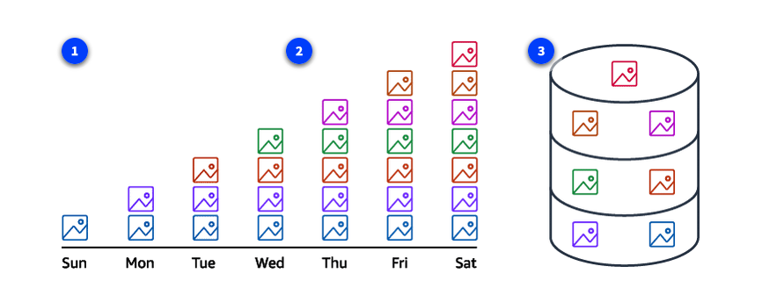
Working with EBS snapshots

Slide 28
Working with EBS snapshots
Initial snapshot
  When you create the first snapshot of an EBS volume, a full copy of all the data on the volume at that point in time is included.
  This initial snapshot serves as the baseline and contains all the data blocks that were in use on the volume.
Subsequent incremental snapshots
  For all snapshots after the initial one, only the blocks that have changed since the last snapshot are captured and stored.
  These are called incremental snapshots. They're much smaller and faster to create than full snapshots.
  Each incremental snapshot contains references to the previous snapshots, creating a chain that allows for point-in-time recovery.
Snapshot consolidation and management
  Despite being incremental, each snapshot appears as a full point-in-time copy of your volume.
  The relationship between multiple snapshots of the same volume are managed automatically.
  When you delete a snapshot, only the data unique to that snapshot is removed.
  Data referenced by other snapshots is preserved.

Slide 29
Benefits
Data protection and recovery
  Snapshots enable fast data recovery from corruption, accidental deletion, or system failures using point-in-time backups.
Operational flexibility
  Snapshots enable operations like cross-Region data migration, volume resizing, volume cloning, and sharing data across AWS accounts.
Cost effective
  Snapshots use incremental backup technology, storing only changed blocks after the initial backup, reducing storage costs and backup time.

Slide 30
Amazon Data Lifecycle Manager
You can automate the creation, retention, and deletion of EBS snapshots using Amazon Data Lifecycle Manager.
Amazon Data Lifecycle Manager can schedule snapshots during off-peak hours to minimize performance impact and automatically delete outdated backups to control storage costs.
It's particularly valuable for large-scale deployments where manual snapshot management would be time-consuming and error-prone.

Slide 31
Amazon Data Lifecycle Manager Workflow
By reducing manual effort and establishing consistent backup policies, Amazon Data Lifecycle Manager helps maintain compliance requirements by scheduling regular backups and enforcing retention rules.
  Create an EBS snapshots policy
    Create an EBS snapshots policy using the Amazon EC2 console, API calls, AWS Command Line Interface (AWS CLI), SDKs, or AWS CloudFormation.
  Select target resource type
    Choose either an EBS volume or an EC2 instance as the target for the snapshot.
  Exclude volumes
    Narrow down the data to be included in the snapshot by choosing options to exclude either the root volume or data volumes.
  Set custom schedules
    Automate the creation, retention, and deletion of EBS snapshots by setting up custom schedules.
  Apply additional actions
    Before finalizing the policy, you can apply additional actions.
    These include configuring elements of the snapshots like tags, snapshot archiving, Amazon EBS fast snapshot restore, cross-Region copying, and cross-account sharing.

Slide 32
Amazon Simple Storage Service (Amazon S3)

Slide 33
In this lesson, you will learn:
Describe Amazon S3, including its benefits and use cases.
Identify the security management features of Amazon S3.

Slide 34
Amazon Simple Storage Service (S3)
Amazon S3 is an object storage service that can store unlimited amounts of data in the AWS Cloud.
Object storage is particularly well-suited for handling large amounts of unstructured data, such as documents, images, and videos.
In this lesson, you will explore some of the core functionality and practical use cases of Amazon S3.

Slide 35
Amazon Simple Storage Service (S3)
Amazon S3 is a fully managed, highly-available object storage service for storing and retrieving any amount of data as objects.
It offers 99.999999999 percent durability, meaning your data is highly protected against loss, and offers features like versioning, lifecycle management, and various storage classes to optimize costs.
Amazon S3 stores files as objects in containers known as buckets, and each object can range in size from a few bytes to several terabytes.
It integrates seamlessly with other AWS services and supports a wide range of use cases, from basic backups to complex data lakes.

Slide 36
Elements of S3
S3 objects
  An object in Amazon S3 is the fundamental unit of data storage.
  When you upload a file to Amazon S3, it becomes an object and is stored durably across multiple facilities within your chosen Region.
  Each object typically includes the data itself, metadata, and a unique identifier, or key.
  Objects can be of any file type, such as images, videos, documents, or application data, and can range in size from a few bytes to several terabytes.
  Each Amazon S3 object is uniquely identified within a bucket by its key, which is essentially its file name.
  Objects also have properties like version ID, access control information, and user-defined metadata.

Slide 37
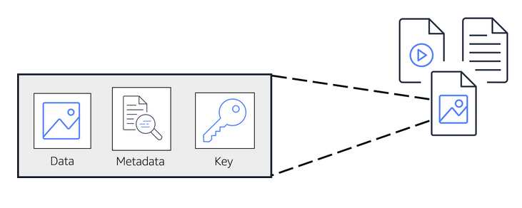
S3 object

Slide 38
Elements
2. S3 buckets
  An S3 bucket is a container for storing objects in Amazon S3.
  Buckets have a globally unique name across all of AWS, which helps to identify and organize your stored data.
  Buckets serve as the basic unit for access control and can hold a virtually unlimited number of objects.
  They play a crucial role in data management by making it possible to group related objects and apply policies at the bucket level.
  When creating a bucket, you specify its name and the Region where it will reside.
  Buckets can be configured with various settings, including versioning, logging, and access permissions.

Slide 39
S3 Benefits
Virtually unlimited storage
  Amazon S3 has no fixed storage limit, scaling automatically to accommodate any amount of data you need to store.
  Since you only pay for the storage you use, it's a cost-effective solution for growing data needs.
Object lifecycle management
  Amazon S3 lifecycle policies automatically move objects between storage classes based on your defined rules, optimizing costs over time.
  You can set up automatic transitions and expirations to manage data throughout its entire lifecycle.
Broad range of use cases
  Amazon S3 supports a wide range of use cases for both cloud-based applications and traditional on-premises workloads.
  Amazon S3 is commonly used for content distribution, hosting static websites, and delivering media files.
  It's also a popular choice for things like application data storage, archiving, data lakes, and compliance-driven data retention.

Slide 40
Security and privacy management
Everything you store in Amazon S3 is private by default.
You must explicitly grant permissions to access these resources.
If you want your Amazon S3 data to be available to everyone on the internet, you can choose to make your buckets and objects public.
To more granularly define who can do what with your Amazon S3 resources, Amazon S3 provides several security management features.

Slide 41
S3 security management features
BUCKET POLICIES
  Amazon S3 bucket policies are resource-based policies that can only be attached to S3 buckets.
  An S3 bucket policy specifies which actions are allowed or denied on the bucket, in addition to every object in that bucket.
IDENTITY-BASED POLICIES
  Permissions that control what actions users, groups, or roles can perform on S3 resources are configured using identity-based policies.
  These policies attach directly to identities rather than to the S3 resources themselves.
  You can use these policies to specify which S3 buckets and objects users can access and what actions they can perform.
ENCRYPTION
  Amazon S3 provides encryption capabilities to protect data both at rest and in transit.
  These encryption features help maintain data confidentiality and comply with various security standards and regulations.
  These capabilities are as follows:
    Encryption at rest secures data stored in S3 buckets, preventing unauthorized access to stored objects.
    Encryption in transit safeguards data traveling to and from Amazon S3, maintaining secure communication between clients and the service.

Slide 42
Amazon S3 Storage Classes and S3 Lifecycle

Slide 43
In this lesson, you will learn:
Describe the different Amazon S3 storage classes and how they differ from each other.
Describe Amazon S3 Lifecycle policies and how they relate to pricing.

Slide 44
Amazon S3 storage classes and use cases
Amazon S3 offers various storage classes to suit a variety of workloads with specific performance, access, resiliency, and cost requirements.
They're also designed to address data residency requirements, unpredictable access patterns, archival storage needs, and offer the most cost-effective options for different access patterns.
Let’s learn about each storage class and when it's practical to use them.

Slide 45
Amazon S3 storage classes and use cases
S3 Standard
  S3 Standard is considered general-purpose storage for cloud applications, dynamic websites, content distribution, mobile and gaming applications, and big data analytics.
  When you upload an object to Amazon S3 without specifying a storage class, the object is added to S3 Standard by default.
S3 Intelligent-Tiering
  This tier is useful if your data has unknown or changing access patterns.
  S3 Intelligent-Tiering stores objects in three tiers: a frequent access tier, an infrequent access tier, and an archive instant access tier.
  Amazon S3 monitors access patterns of your data and automatically moves your data to the most cost-effective storage tier based on frequency of access.
S3 Standard Infrequent Access (Standard-IA)
  S3 Standard-Infrequent Access (S3 Standard-IA) is for data that is accessed less frequently but requires rapid access when needed.
  S3 Standard-IA offers the high durability, high throughput, and low latency of S3 Standard, with a low per-GiB storage price and per-GiB retrieval fee.
  This storage tier is ideal if you want to store long-term backups, disaster recovery files, and so on.

Slide 46
Amazon S3 storage classes and use cases
S3 One Zone Infrequent Access (One Zone-IA)
  S3 One Zone-Infrequent Access (S3 One Zone-IA) stores data in a single Availability Zone, reducing costs compared to S3 Standard-IA, which uses three zones.
  This storage class suits customers seeking affordable storage for infrequently accessed data without high availability needs.
  It's perfect for storing secondary backups or easily re-creatable data.
S3 Express One Zone
  S3 Express One Zone stores data in a single Availability Zone.
  It was purpose-built to deliver consistent single-digit millisecond data access for your most frequently accessed data and latency-sensitive applications.
  S3 Express One Zone delivers data access speed up to 10x faster and request costs up to 80% lower than S3 Standard.
S3 Glacier Instant Retrieval
  Use S3 Glacier Instant Retrieval for archiving data that is rarely accessed and requires millisecond retrieval.
  Data stored in this storage class offers a cost savings of up to 68 percent compared to the S3 Standard-IA storage class, with the same latency and throughput performance.

Slide 47
Amazon S3 storage classes and use cases
S3 Glacier Flexible Retrieval
  S3 Glacier Flexible Retrieval offers low-cost storage for archived data that is accessed 1–2 times per year.
  With S3 Glacier Flexible Retrieval, your data can be accessed in as little as 1–5 minutes using an expedited retrieval.
  You can also request bulk retrievals in up to 5–12 hours at no additional cost.
  It's an ideal solution for backup, disaster recovery, offsite data storage needs, and for when some data occasionally must be retrieved in minutes.
S3 Glacier Deep Archive
  S3 Glacier Deep Archive is the lowest-cost Amazon S3 storage class.
  It supports long-term retention and digital preservation for data that might be accessed once or twice per year.
  Data stored in the S3 Glacier Deep Archive storage class has a default retrieval time of 12 hours.
  It is designed for customers that retain data sets for 7–10 years or longer, to meet regulatory compliance requirements.
  Examples include those in highly regulated industries, such as financial services, healthcare, and public sectors.
S3 Outposts
  Amazon S3 Outposts delivers object storage to your on-premises AWS Outposts environment using Amazon S3 APIs and features, and serves workloads with local data residency requirements.
  It also helps maintain optimal performance when data must remain in close proximity to on-premises applications.

Slide 48
S3 Lifecycle
To avoid manually managing your object storage tier configurations, you can use S3 Lifecycle configurations to automate the process.
When you define a lifecycle configuration for an object or group of objects, you can choose to automate between two types of actions, as follows:
  Transition actions: define when objects should transition to another storage class.
  Expiration actions: define when objects expire and should be permanently deleted.
For example, you might transition objects to S3 Standard-IA storage class 30 days after you create them. Or you might archive objects to the S3 Glacier Deep Archive storage class 1 year after creating them.

Slide 49
Use cases
The following situations are candidates for the use of S3 lifecycle configuration rules:
Periodic logs: If you upload periodic logs to a bucket, your application might need them for a week or a month. After that, you might want to delete them.
Data that changes in access frequency: Some documents are frequently accessed for a limited period of time. After that, they are infrequently accessed. At some point, you might not need real-time access to them. However, your organization or regulations might require you to archive them for a specific period. After that, you can delete them.

Slide 50
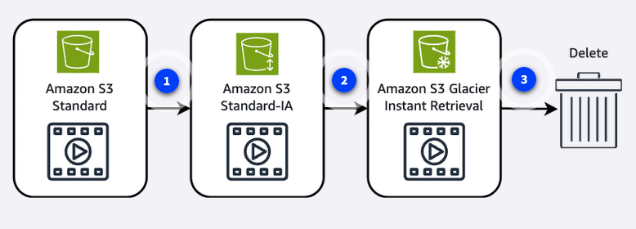
Use case Example
After 30 days
  After 30 days without being accessed, the object is moved from the Amazon S3 Standard storage class to the Amazon S3 Standard-IA storage class.
After 60 days
  After the object has been in the S3 Standard-IA storage class for 60 days without being accessed, it's moved to the Amazon S3 Glacier Instant Retrieval storage class.
After 365 days
  Finally, after 365 days in the Amazon S3 Glacier Instant Retrieval storage class without being accessed,
  the object is deleted.

Slide 51
Amazon S3 Demonstration

Slide 52
In this lesson, you will learn:
Navigate in the AWS Management Console.
Create and configure an Amazon S3 bucket.
Upload individual files and complete folders to Amazon S3.
Configure both system-defined and user-defined object metadata.

Slide 53
About the Demo
This demonstration offers a hands-on exploration of the fundamental features of Amazon S3 through the AWS Management Console.
You will be guided through the process of creating storage buckets, uploading files and folders, and configuring essential settings for both buckets and objects.
Whether you're storing application data, website files, or backup archives, this demonstration will show you how to get started with the core functionality of Amazon S3.

Slide 54
Amazon S3 Basics – Demo Summary
Create a Bucket
  Buckets must have a globally unique name.
  Choose an AWS Region.
  By default, block all public access is enabled for security.
Organizing Data
  Create folders inside the bucket for structure.
  Upload files into folders using:
    Add files (single/multiple files).
    Drag & drop (folders + contents, preserving hierarchy).
  Files in S3 are called objects.
Object Metadata
  System-defined: size, creation date, storage class.
  User-defined: custom tags/metadata for organization.

Slide 55
Amazon S3 Basics – Demo Summary
4. Bucket Configurations
  Properties tab: versioning, encryption, intelligent-tiering, static website hosting, etc.
  Permissions tab: control access with:
    Block Public Access.
    Bucket policies (JSON-based rules).
    CORS, object ownership.
  Management tab: lifecycle rules, replication, and inventory.
5. Bucket Policy Example
  Can grant cross-account access to upload objects.
  Defines effect (allow/deny), principal (who), action (e.g., s3:PutObject),
  resource (what), and conditions (ownership metadata).
6. Object-Level Features
  Overview: object URL, size, storage class.
  Permissions: controlled via bucket policy.
  Properties: encryption, checksums, tags, object lock.
  Versions tab: view, restore, or delete older versions.

Slide 56
Amazon Elastic File System (Amazon EFS)

Slide 57
In this lesson, you will learn:
Describe Amazon EFS, including its benefits and use cases.
Describe Amazon EFS storage classes and how they can impact pricing.
Describe the EFS lifecycle policies and how they interact with storage classes.

Slide 58
Amazon Elastic File System (EFS)
Amazon EFS is a fully managed, scalable file storage service for use with AWS cloud services and on-premises resources. I
t operates using the Linux Network File System (NFS) protocol, and automatically scales to petabytes as you add or remove files without disrupting applications.
EFS is designed to support a wide variety of workloads and can be accessed by multiple EC2 instances simultaneously.

Slide 59
Amazon EFS benefits
Multi-AZ redundancy
  Amazon EFS automatically replicates data across multiple Availability Zones in a region for high availability.
  This built-in redundancy protects against AZ failures and provides continuous access to your file systems.
Shared access
  Amazon EFS supports thousands of concurrent NFS connections, so multiple EC2 instances can access the same file system simultaneously.
  This shared access model makes EFS ideal for collaborative workloads and distributed applications.
Elastic storage
  Amazon EFS automatically grows and shrinks as you add and remove files, with no need to provision or manage storage capacity.
  And since you only pay for the storage you use, it's cost-effective for varying workload demands.

Slide 60
Amazon EFS storage classes
With Amazon EFS, you can create and configure file systems quickly without any minimum fee or setup cost.
You pay only for the storage used and you can choose from a range of storage classes designed to fit your use case:
  Standard storage classes
  One zone storage classes
  Archive storage classes

Slide 61
Amazon EFS storage classes
Standard storage classes
  The EFS Standard and EFS Standard-Infrequent Access (Standard-IA) storage classes offer Multi-AZ resilience and the highest levels of durability and availability.
  They have a higher cost associated with them due to higher availability and durability.
One zone storage classes
  The EFS One Zone and EFS One Zone-Infrequent Access (EFS One Zone-IA) provide additional savings by saving your data in a single Availability Zone.
  By using just one Availability Zone, you can reduce your storage costs when compared to the Standard EFS storage classes.
Archive storage classes
  The EFS Archive storage class is cost-optimized for data that is accessed only a few times a year or less and that does not need the sub-millisecond latencies of EFS Standard.
  EFS Archive offers a storage price up to 50% lower compared to EFS Infrequent Access, providing a more cost-optimized experience for cold, rarely-accessed data.

Slide 62
Amazon EFS data lifecycle
You can further optimize Amazon EFS storage costs by automatically moving data between storage classes based on usage patterns.
You can create lifecycle policies that determine when and how files transition between different storage tiers.
These automated policies help ensure your data resides in the most cost-effective storage class without manual intervention.

Slide 63
Amazon EFS data lifecycle
Transition to IA
  This policy instructs lifecycle management when to move files into the Infrequent Access storage, which is cost-optimized for data that is accessed only a few times each quarter.
  By default, files that are not accessed in Standard storage for 30 days are transitioned into IA.
Transition to Archive
  This policy instructs lifecycle management when to move files into the Archive storage class, which is cost-optimized for data that is accessed only a few times each year or less.
  By default, files that are not accessed in Standard storage for 90 days are transitioned into Archive.

Slide 64
Amazon EFS data lifecycle
Transition to Standard
  This policy instructs lifecycle management whether to transition files out of IA or Archive and back into Standard storage when the files are accessed in the IA or Archive storage.
  By default, files are not moved back to Standard storage, and they remain in the IA or Archive storage class when they are accessed.

Slide 65
Amazon FSx

Slide 66
In this lesson, you will learn:
Describe Amazon FSx, including its benefits and use cases.
Describe the available file system options for Amazon FSx.

Slide 67
Amazon FSx
Amazon FSx makes it convenient and cost effective to launch, run, and scale feature-rich, high-performance file systems in the cloud.
It supports a wide range of workloads with its reliability, security, scalability, and broad set of capabilities.
Compared to Amazon EFS, which focuses on the Network File System (NFS) compatibility, Amazon FSx supports multiple filesystem protocols, including Windows File Server, Lustre, OpenZFS, and NetAPP ONTAP.
Amazon FSx is built on the latest AWS compute, networking, and disk technologies to provide high performance and lower total cost of ownership (TCO).
As a fully managed service, it handles hardware provisioning, patching, and backups.

Slide 68
Amazon FSx benefits
File system integration
  Amazon FSx supports industry-standard file system protocols, allowing convenient integration with your existing applications, workflows, and development tools.
Managed infrastructure
  Amazon FSx reduces the complexity of managing infrastructure while delivering the features and capabilities of traditional file systems.
Scalable storage
  Amazon FSx adjusts resources dynamically, eliminating the need for complex capacity planning and manual infrastructure management.
Cost effective
  Amazon FSx has a pricing model and automated tiering options that optimize costs by charging only for used storage and moving infrequently accessed data to lower-cost tiers.

Slide 69
Amazon FSx file systems

Slide 70
Amazon FSx for Windows File Server
Amazon FSx for Windows File Server provides fully managed shared storage built on Windows Server.
It delivers a wide range of data access, data management, and administrative capabilities.
Use cases include the following:
  Migrate Windows file servers to AWS.
  Accelerate hybrid workloads.
  Reduce SQL Server deployment cost.
  Streamline virtual desktops and streaming.

Slide 71
Amazon FSx for NetApp ONTAP
Amazon FSx for NetApp ONTAP provides fully managed shared storage in the AWS Cloud with the popular data access and management capabilities of ONTAP.
Use cases include the following:
  Migrate workloads to AWS seamlessly.
  Build modern applications.
  Modernize your data management.
  Streamline business continuity.

Slide 72
Amazon FSx for OpenZFS
Amazon FSx for OpenZFS provides fully managed shared file storage built on the OpenZFS file system and accessible through the NFS protocol (v3, v4, v4.1, and v4.2).
Use cases include the following:
  Migrate workloads to AWS seamlessly.
  Deliver insights faster for data analytics workloads.
  Accelerate content management.
  Increase dev/test velocity.

Slide 73
Amazon FSx for Lustre
Amazon FSx for Lustre provides fully managed shared storage with the scalability and performance of the popular Lustre file system.
Use cases include the following:
  Accelerate machine learning (ML).
  Enable high performance computing (HPC).
  Unlock big data analytics.
  Increase media workload agility.

Slide 74
AWS Storage Gateway

Slide 75
In this lesson, you will learn:
Describe AWS Storage Gateway, including its benefits and use cases.
Describe the three available gateway types in Storage Gateway.

Slide 76
AWS Storage Gateway
Storage Gateway is a hybrid cloud storage service that makes it possible to seamlessly integrate on-premises environments with AWS Cloud storage.
You can use it to extend your local storage to the cloud while maintaining low-latency access to frequently used data.
You can use Storage Gateway to streamline storage management and reduce costs for practical hybrid cloud storage use cases.
These include moving backups to the cloud, using on-premises file shares backed by cloud storage, and providing low-latency access to data in AWS for on-premises applications.

Slide 77
Benefits
Seamless integration
  Storage Gateway enables smooth connectivity between on-premises applications and AWS Cloud storage, preserving existing workflows and minimizing disruption.
Improved data management
  Storage Gateway provides centralized management of hybrid storage environments, enhancing accessibility, security, and compliance.
Local caching
  Storage Gateway locally keeps frequently accessed data for quick access while managing less-used data in the cloud.
Cost optimization
  Storage Gateway reduces on-premises storage costs by using cloud storage for data archiving, backup, and disaster recovery purposes.

Slide 78
Gateway types

Slide 79
Amazon S3 File Gateway
Amazon S3 File Gateway bridges your local environment with Amazon S3.
It provides on-premises applications with access to virtually unlimited cloud storage through familiar file protocols.
S3 File Gateway makes it possible to store and retrieve cloud objects using familiar file operations.
When you deploy an S3 File Gateway, it appears to your local systems as a standard file server.
Files written to this server are automatically uploaded to Amazon S3 while maintaining local access to recently used data through intelligent caching.
This means your applications can continue working with files as they always have while the actual data is securely stored in the AWS Cloud.

Slide 80
Volume Gateway
With Volume Gateway, you create virtual storage volumes while maintaining local access to your data.
It essentially functions as a bridge between your on-premises infrastructure and AWS Cloud storage by presenting your cloud data as iSCSI volumes that can be mounted by your existing applications.
Volume Gateway operates in two main configurations:
  Cached volume mode stores primary data in the cloud while frequently accessed data is cached locally for low-latency access.
  Stored volume mode locally keeps your complete dataset while asynchronously backing it up to the cloud as EBS snapshots.

Slide 81
Tape Gateway
Tape Gateway makes it possible to replace physical tape infrastructure with virtual tape capabilities while benefitting from the durability and scalability of AWS Cloud storage.
Tape Gateway provides an interface that works with existing tape backup software, making the transition from physical tapes to cloud storage seamless.
When you deploy a Tape Gateway, it presents itself to your backup applications as standard tape hardware.
Your backup software writes data to these virtual tapes just as it would to physical tapes and stored in Amazon S3.
You can also configure Tape Gateway to automatically transition less frequently accessed data to a more cost-effective storage class for long-term retention.

Slide 82
AWS Elastic Disaster Recovery

Slide 83
In this lesson, you will learn:
Describe Elastic Disaster Recovery, including its benefits and use cases

Slide 84
AWS Elastic Disaster Recovery
Elastic Disaster Recovery replicates critical workloads to AWS with minimal downtime.
Your servers' block-level data is continuously replicated to AWS, making it ideal for uses that require robust disaster recovery solutions.
It supports both physical and virtual servers to enable rapid recovery during disruptions, which is particularly valuable for industries like healthcare where system availability is crucial.
You can use Elastic Disaster Recovery to reduce downtimes and data loss while eliminating the costs associated with maintaining secondary data centers.
It also offers non-disruptive disaster recovery testing, meaning it's capable of quickly launching recovery instances when needed.

Slide 85
Benefits
Business resilience
  Maintain business operations with continuous block-level data replication and the ability to recover workloads within minutes during disruptions.
Streamlined disaster recovery
  Automate disaster recovery processes through an intuitive console, reducing complex manual configurations and minimizing the risk of human error.
Cost optimization
  Eliminate expensive secondary data centers and pay only for what you use, with minimal upfront investment and no standby infrastructure costs.

Slide 86
Use cases
Healthcare data protection
  Hospital systems could use Elastic Disaster Recovery to maintain compliance while protecting patient records by replicating on-premises servers to AWS.
  This ensures that critical medical data remains accessible during system outages.
  Regular disaster recovery testing helps validate their recovery procedures and meet strict healthcare regulations.

Slide 87
Use cases
Financial services continuity
  A regional bank could implement Elastic Disaster Recovery to protect their core banking applications by continuously replicating their transaction processing systems.
  This facilitates quick recovery if their primary data center fails and helps maintain customer trust and regulatory compliance.

Slide 88
Use cases
Manufacturing operations recovery
  A global manufacturer could employ Elastic Disaster Recovery to protect their production planning systems.
  By replicating factory management servers to AWS, they can ensure minimal disruption to supply chain operations during disasters.
  Regular failover testing validates the recovery strategy.

Slide 89
Comparing Storage Services

Slide 90
In this lesson, you will learn:
Explain how a company might use AWS storage services for different real-world scenarios.
In this Cloud in Real Life Demo, you will learn about three real-world scenarios involving Amazon S3, Amazon EBS, and Amazon EFS.
We will explain how these services solve specific business challenges for different industries.
By the end, you will understand the key differences between the different AWS storage services and their ideal use cases.

Slide 91
The Coffee Shop Website
Situation:
  Small local shop wants to host a website with menus, photos, opening hours.
  Expecting sudden traffic bursts (tourists, seasonal events).
  No database needed, just static files (HTML, CSS, JS, images).
  Budget is tight, so cost efficiency matters.
  They don’t want to manage servers.

Slide 92
The Fitness Center Database
Situation:
  A growing fitness chain with an app storing user progress, workout history, payments.
  Needs fast and consistent read/write performance.
  Database should not lose data if a server fails.
  Predictable workloads, but must handle thousands of members.

Slide 93
The Automotive Repair Shops
Situation:
  Chain of auto repair shops worldwide.
  Mechanics need to upload, share, and view videos, manuals, and diagnostic data in real-time.
  Content is large (media-rich) and accessed by multiple employees at the same time.
  Files are updated collaboratively (not just static like in S3).
  They don’t want to run/maintain complex file servers.

Slide 94
Amazon S3 (Object Storage)
Best for static assets like website files, media, and backups.
Automatically scales to handle any traffic.
Cost-effective — you pay only for what you use.
Perfect fit for the coffee shop’s static website.

Slide 95
Amazon EBS (Block Storage)
Provides low-latency, block-level storage for EC2 instances.
Critical for databases and transactional workloads.
Performance can be optimized by choosing the right volume type (e.g., Provisioned IOPS SSD).
Perfect fit for the fitness center’s database.

Slide 96
Amazon EFS (Shared File Storage)
Managed file system that multiple EC2 instances can access simultaneously.
Automatically scales up or down to petabytes.
Ideal for shared, collaborative workloads with media and real-time access needs.
Perfect fit for the automotive repair shops’ knowledge-sharing platform.

Slide 97
Recap
In this module, you learned about the diverse storage options available in AWS, starting with block storage services like Amazon EC2 Instance Store and Amazon EBS.
You learned how Amazon EBS provides persistent block storage volumes for EC2 instances, while EC2 instance store offers temporary block-level storage.
You learned how to use EBS snapshots and AWS Data Lifecycle Manager for automated backup management and data protection.
You then examined Amazon S3, a highly scalable object storage service that serves as a foundation for many cloud storage needs.
You delved into file storage solutions, including Amazon Elastic File System (Amazon EFS) for Linux-based workloads and Amazon FSx for Windows, Lustre, OpenZFS, and NetAPP ONTAP file systems.
Finally, you learned about AWS Storage Gateway, which bridges on-premises environments with AWS storage services to enable hybrid cloud storage architectures.

Slide 98
Resources
Resource link | Description
Amazon EC2 Instance Store User Guide | A temporary storage option that is directly attached to the host computer of an EC2 instance, providing high-performance but non-persistent storage.
Amazon Elastic Block Store (Amazon EBS) | A scalable block storage service that provides persistent, high-performance volumes you can attach to your EC2 instances for data storage and applications.
Amazon Elastic Block Store (Amazon EBS) FAQ | Frequently asked questions about Amazon EBS.
Amazon EBS Snapshots User Guide | EBS Snapshots are point-in-time backups of your cloud storage volumes, making it possible to protect data and restore it when needed.
Amazon Data Lifecycle Manager User Guide | A service that streamlines the creation, retention, and deletion of Amazon EBS snapshots.
Amazon Simple Storage Service (Amazon S3) | A scalable cloud storage service that can store and retrieve any amount of data from anywhere on the web.
Amazon Simple Storage Service (Amazon S3) FAQ | Frequently asked questions about Amazon S3.
Amazon S3 Storage Classes | Amazon S3 offers various storage classes, from high-performance frequent access to cost-effective archival options, tailored to different data retrieval needs and budget constraints.
Amazon S3 Versioning User Guide | Amazon S3 versioning keeps multiple variants of objects, offering recovery from unintended deletions or modifications by preserving every update to your files.
Amazon S3 Buckets User Guide | S3 buckets are cloud storage containers that securely hold various types of data, allowing convenient access and management through the AWS online infrastructure.
Amazon Elastic File System (Amazon EFS) | A scalable, fully-managed file storage service that lets multiple AWS resources access shared data simultaneously without capacity planning.
Amazon Elastic File System (Amazon EFS) FAQ | Frequently asked questions about Amazon EFS.
Amazon FSx | A fully managed file storage service that lets you launch and run file systems like Windows File Server, Lustre, NetApp ONTAP, and OpenZFS in the AWS cloud.
Amazon FSx for Windows File Server | An Amazon FSx option providing reliable, high-performance file storage compatible with Windows applications in the AWS Cloud.
Amazon FSx for NetApp ONTAP | An Amazon FSx option providing file storage with advanced data management capabilities and compatibility with both Windows and Linux workloads on AWS.
Amazon FSx for OpenZFS | An Amazon FSx option that provides high-performance, scalable storage using the popular open-source ZFS file system.
Amazon FSx for Lustre | An Amazon FSx option designed to accelerate workloads by providing fast data access for compute-intensive applications in AWS.
AWS Storage Gateway | A hybrid cloud storage service that provides seamless and secure integration between on-premises environment and AWS cloud storage services.
Amazon S3 File Gateway | A Storage Gateway configuration that provides local file access to S3 objects while caching frequently accessed data locally for faster retrieval.
Tape Gateway | A Storage Gateway configuration used for backing up data to Amazon S3 while maintaining compatibility with existing tape-based backup applications.
Volume Gateway | A Storage Gateway configuration that provides iSCSI block storage volumes to on-premises applications, offering both cached and stored modes.

